Slide 1
Topological Physics in Band Insulators
Topological Insulators in Two and Three Dimensions

Slide 2

The canonical list of electric forms of matter is actually incomplete
Conductor
18th century
Insulator
Superconductor
20th century
Topological Insulator

Slide 3
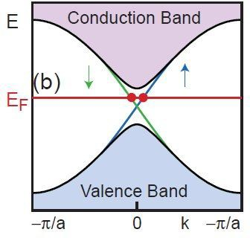
Electronic States of Matter
Topological Insulators
This novel electronic state of matter is gapped in the bulk and supports the transport of spin and charge in gapless edge states that propagate at the sample boundaries. The edge states are … insensitive to disorder because their directionality is correlated with spin.
2005 Charlie Kane and GM University of Pennsylvania
Electron spin admits a topologically distinct insulating state

Slide 4
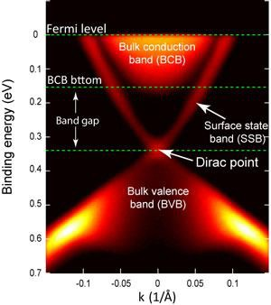
Electronic States of Matter
Topological Insulators
This state is realized in three dimensional materials where spin orbit coupling produces a bandgap “inversion.”
It has boundary modes (surface states) with a 2D Dirac singularity protected by time reversal symmetry.
Bi₂Se₃ is a prototype.
.
Hasan/Cava (2009)

Slide 5
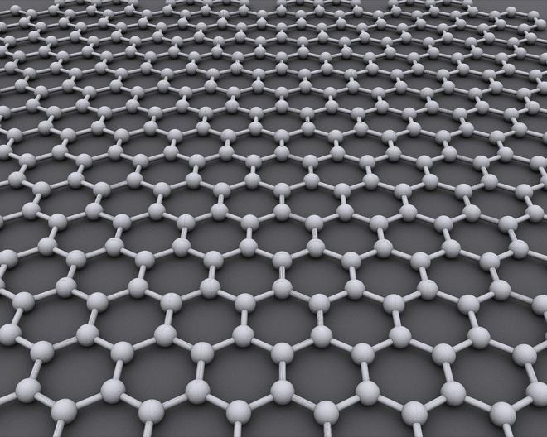
Graphene: the Parent Phase

Slide 6
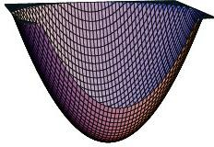
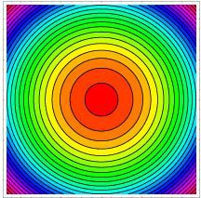
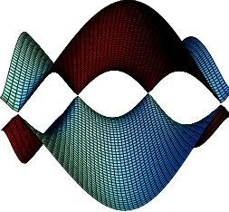
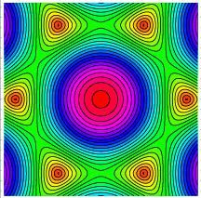
…. it has a critical electronic state
The dispersion of a free particle in 2D..
…is replaced
by an unconventional
E(k) relation on the graphene lattice

Slide 7
The low energy theory is described by
an effective mass theory for massless electrons
(Bloch Wavefunction ) = (Wavefunction(s) at K ) •ψ (r )
H ψ (r→) = −iv (σ→ •∇)ψ (r→)
eff F
It is a massless Dirac Theory in 2+1 Dimensions
NOTE: Here the “spin” degree of freedom describes the sublattice polarization of the state, called pseudospin. In addition electrons carry a physical spin ½ and an isospin ½ describing the valley degeneracy.
D.P. DiVincenzo and GM (1984)

Slide 8
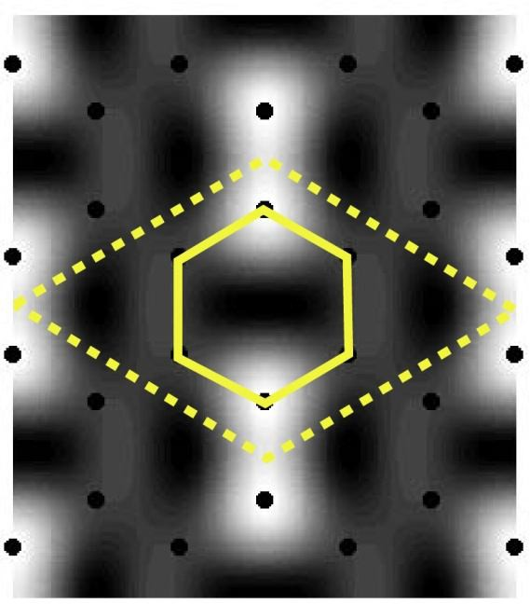
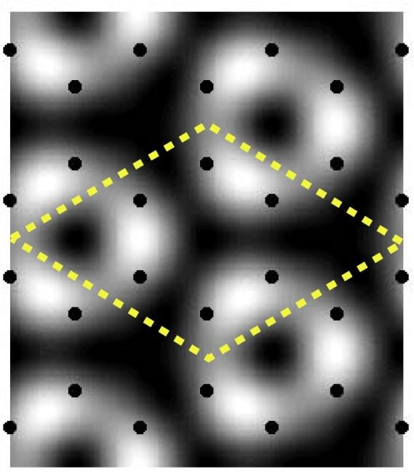
Gapping the Dirac Point
Valley mixing from broken translational symmetry
A continuum of structures all with
√3 x √3 period hybridizes the two valleys

Slide 9
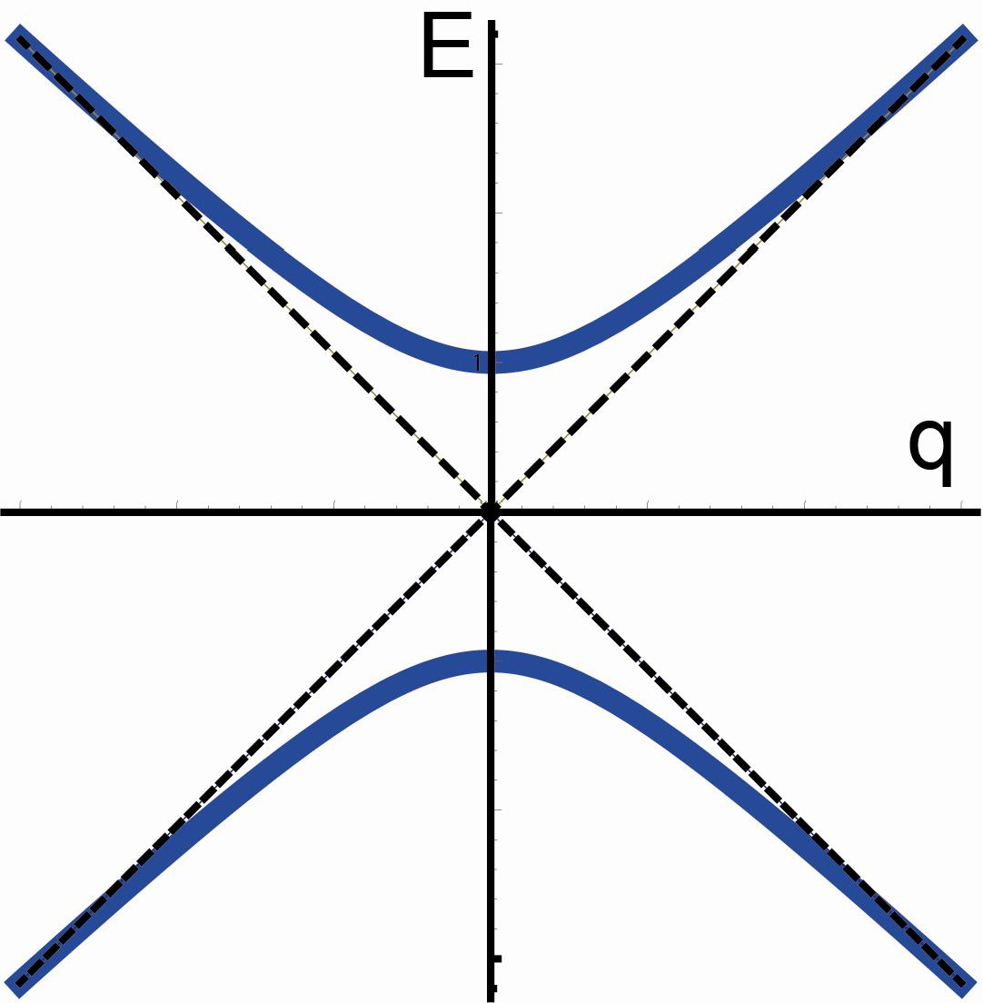
Gapping the Dirac Point
Valley mixing from broken translational symmetry
_{e}iϑ_{σ ⎞}
⎛
0
x ⎟
H ' = Δ
Kekule ⎜
_{e}−iϑ_{σ}
⎝
0
⎠_{τ}
x

Slide 10
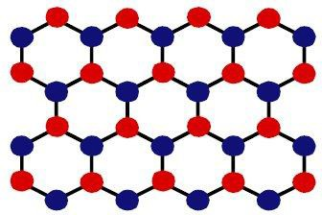
Gapping the Dirac Point
Charge transfer from broken inversion symmetry

Slide 11
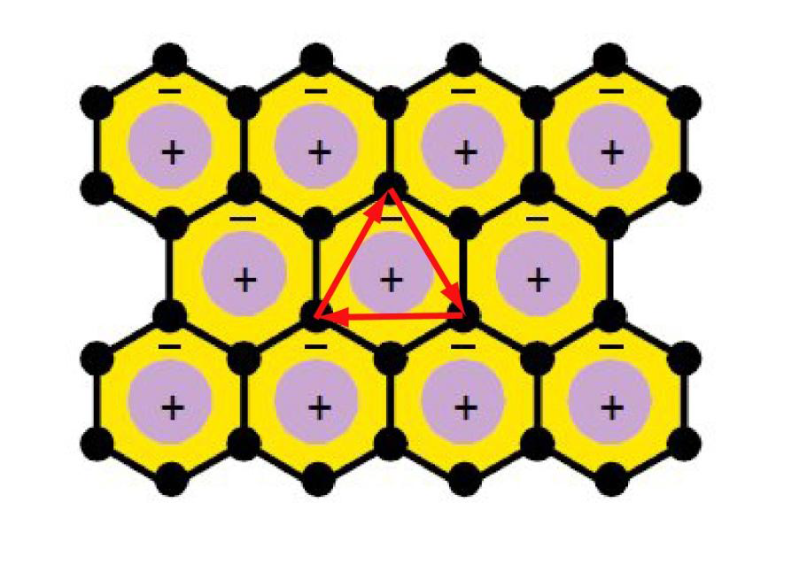
Gapping the Dirac Point
Orbital currents from modulated flux (Broken T-symmetry)
⎛σ _{z} 0 ⎞
H ' = Δ
⎜
FDMH
⎝
0 −σ ⎟
z ⎠_{τ}
Gauged second neighbor hopping breaks T. “Chern insulator” with Hall conductance e²/h
FDM Haldane “Quantum Hall Effect without Landau Levels” (1988)

Slide 12

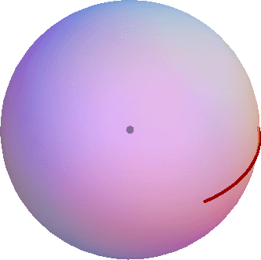
Topological Classification
⎛σ _{z} 0 ⎞
H ' = Δ
⎜
FDMH
⎝
0 −σ ⎟
, k ) ⋅ ∂
z ⎠_{τ}
⎡ →
(
→ → ⎤
∫
)
n = ¹
2
d k d (k
d ×∂ d
= 1
4π
⎣
1 2
k
1
k
2
⎦
S
_{e}2
“Chern Insulator” with
σ _{xy} =
(has equal contributions from two valleys)
h

Slide 13

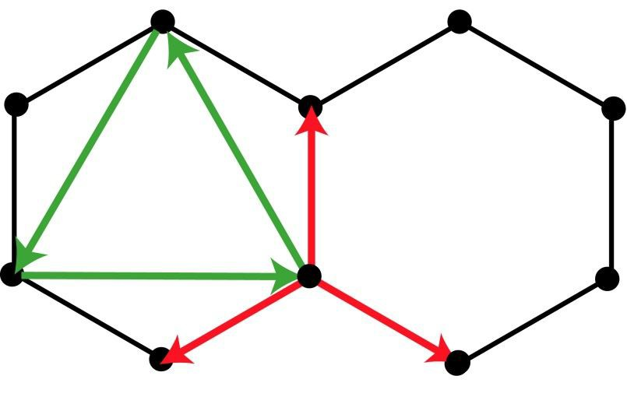
Orthodoxy: Spectrum Gapped only for Broken Symmetry States
Breaks P
H (k) = t∑cos k ⋅ → σ + sin k ⋅ → σ + Mσ
a_{n} a_{n}
x y z
n
→ → → →
+2t₂ ∑cos Φcos k ⋅ b_{n '} σ ₀ −sin Φsin k ⋅ b_{n '} σ _{z} n '
Breaks e-h symmetry Breaks T
{a_{n} }:
triad of nearest neighbor bond vectors
{b }:
triad of directed “left turn” second neighbor bond vectors
n '
Crucially, this ignores the electron spin

Slide 14
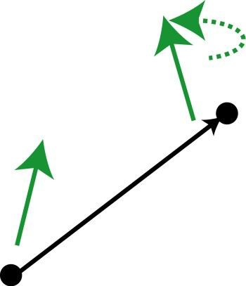
Coupling orbital motion to the electron spin
→ ₌
Microscopic H = s ⋅∇V × p V (r ) V (r
→ + T )
SO
→ →
→
H = iλ ψ
( )
σ ψ −ψ
σ ψ ⋅ε→ ×(r→
m
Lattice model
†
m n
†
n m
− r_{n} )
SO
Spin orbit field
Bond vector
Intersite hopping with spin precession

Slide 15
Coupling orbital motion to the electron spin
Breaking mirror symmetry with a perpendicular spin orbit field
ε _{xy} = 0, ε _{z} ≠ 0 H_{R} = s ⋅ε nˆ × p = −ε nˆ ⋅ s × p
n ⋅ s × d )ψ
(
→
−itψ
†
ˆ
1 n
mn m
Modifies first neighbor coupling by spin dependent potential
Δ_{R} = λ_{R} (σ _{x}τ _{z} s_{y} − σ _{y} s_{x} )
Renormalizes Fermi velocity and can fission the Dirac point

Slide 16
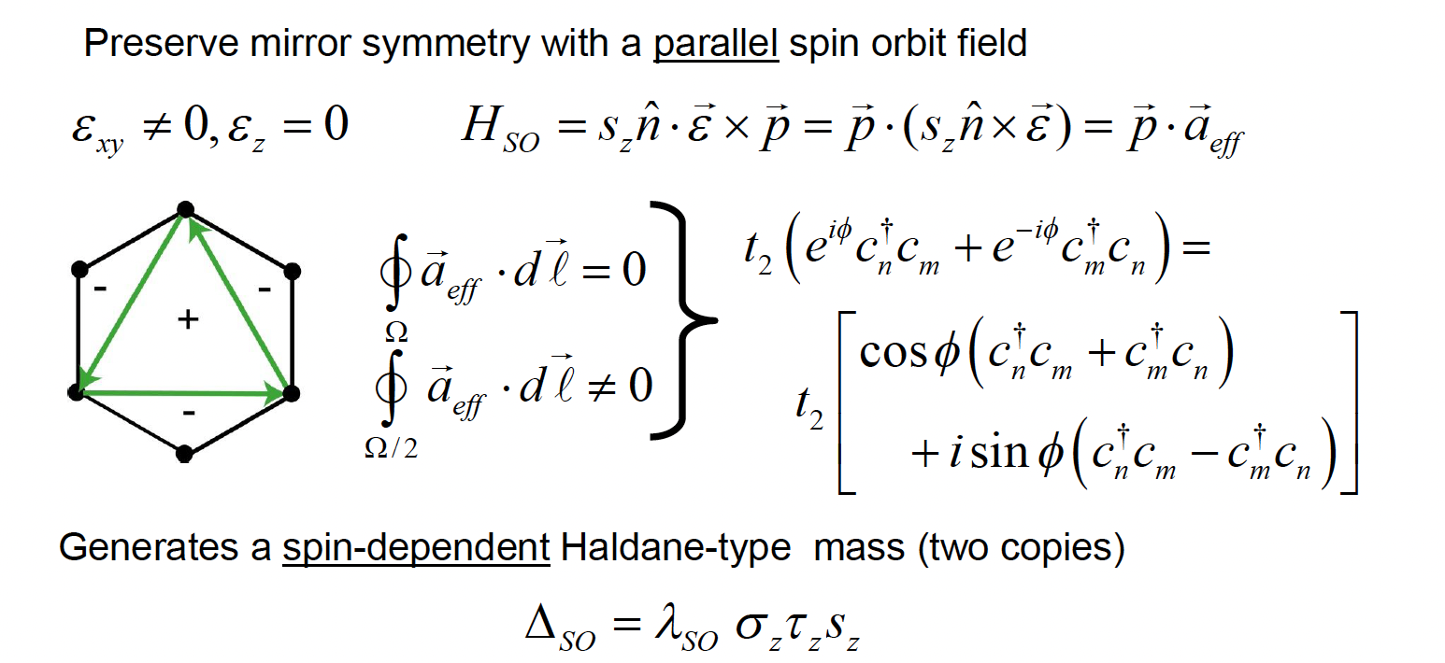
Coupling orbital motion to the electron spin

Slide 17
Mass Terms (amended)
σ _{x}τ _{x} ,σ _{x}τ _{y}
Kekule: valley mixing
σ _{z}
Heteropolar (breaks P)
Modulated flux (breaks T)
spinless
σ _{z}τ _{z}
σ _{x}τ _{z} s_{y} − σ _{y} s_{x}
Spin orbit (Rashba, broken z→-z)
Spin orbit (parallel)*
σ _{z}τ _{z} s_{z}
*This term respects all symmetries and
is therefore present, though possibly weak
For carbon definitely weak, but still important

Slide 18
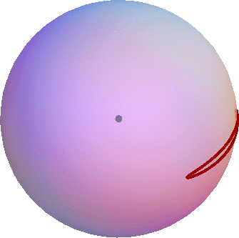
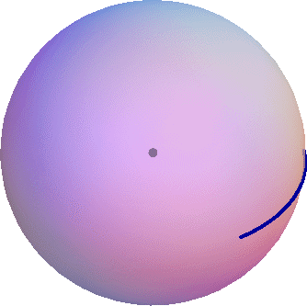
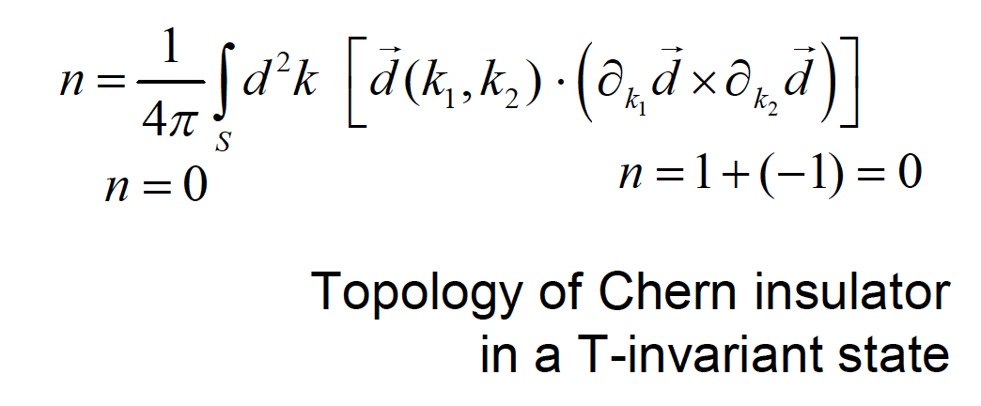
Topologically different states
Charge transfer insulator Spin orbit coupled insulator

Slide 19
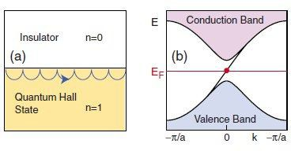
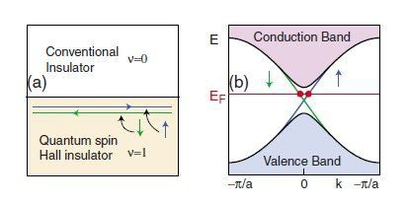
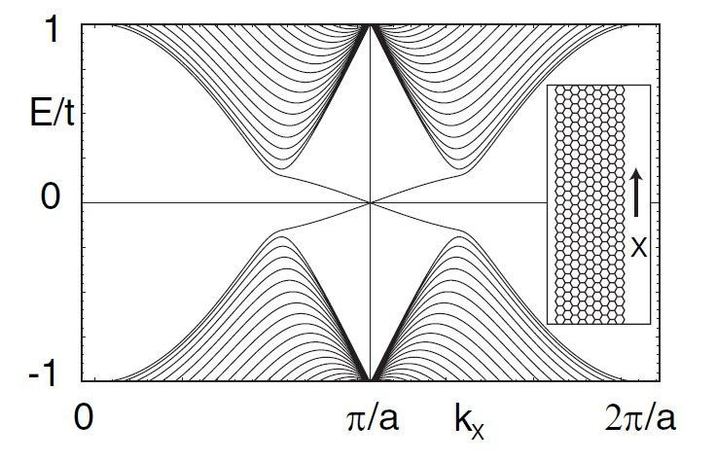
Boundary Modes
Ballistic propagation through one-way edge state
Intrinsic SO-Graphene model on a ribbon
Counter propagating spin
polarized edge states

Slide 20
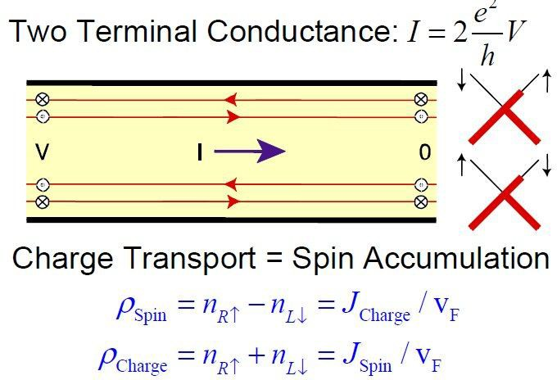
Quantum Spin Hall Effect
Its boundary modes are spin filtered propagating surface states (edge states)

Slide 21
Comments
The H² model conserves S_{z} and is oversimplified. Spin, unlike charge, is not conserved.
But the edge state picture is robust!
Boundary modes: Kramers pair
Band crossing protected by T-reversal symmetry
Elastic backscattering eliminated by T-symmetry
QSHE: quantum but not quantized

Slide 22
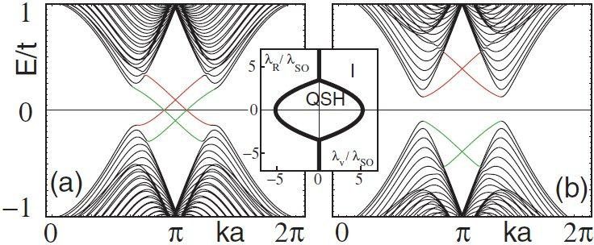
More comments
Counter-propagating surface modes reflect the bulk topological order. They can only be eliminated by a phase transition to a non-topological phase.
weak sublattice symmetry breaking
strong sublattice symmetry breaking

Slide 23
Symmetry Classification
Conductors: unbroken state¹
Insulators: broken translational symmetry: bandgap from Bragg reflection²
Superconductor: broken gauge symmetry Topological Insulator ?
¹possibly with mass anisotropy
²band insulators

Slide 24
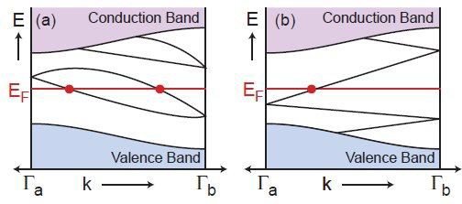
Symmetry Classification
Ordinary insulators and topological insulators are distinguished by a two-valued (even-odd) surface index.
Kramers Theorem: T-symmetry requires E(k,↑) =E(-k,↓)
But at special points k and -k are identified (TRIM)
even: ordinary (trivial)
odd: topological
Kane and GM (2005)

Slide 25
Bulk Signature
The surface modes reflect bulk topological order distinguished by a bulk symmetry
e.g. TKKN invariant = Chern number = Hall conductance
⎡ → → → ⎤
∫
( )
n = ¹
2
d k d (k
, k ) ⋅ ∂
d ×∂ d
⎣ ⎦
4π
1 2
k
k
1 2
S
T-reversal symmetry requires n=0
“Spin Chern number” in S_{z} conserving model is nontopological
TI index is defined mod 2

Slide 26
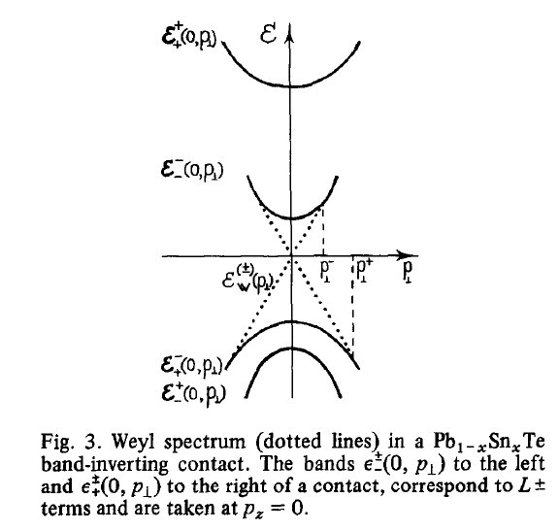
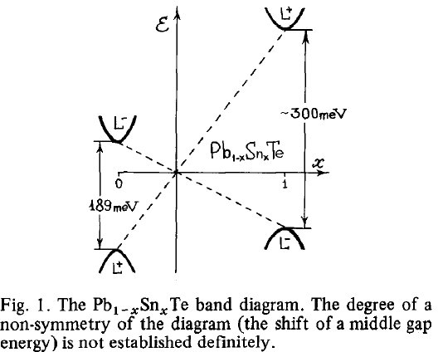
History: special interface states at a band-inverting junction
B. A. Volkov and O. A. Pankratov, JETP Lett. 42, 178 (1985)
Pb_{1-x}Sn_{x}Te alloys: interface states controlled by asymptotics

Slide 27
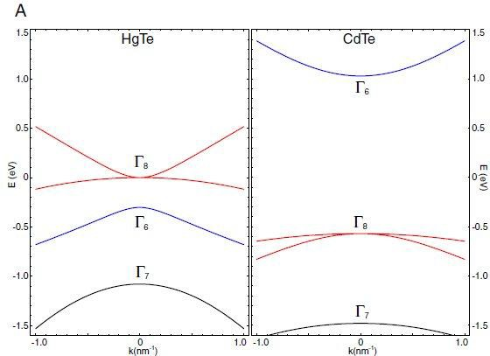
Band inversion in II-VI semiconductors
J=1/2
antibonding s
J=3/2
bonding p
J=3/2
bonding p
“inverted”
“conventional”

Slide 28
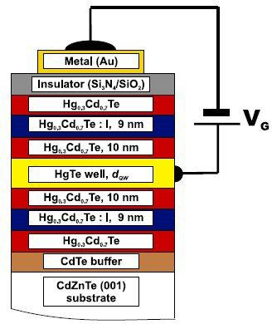
Recent history: level ordering in a II-VI (001) quantum well
k=0 states are indexed by axial symmetry
Ψ_{±1/ 2} = α Γ₆ , ±1/ 2 + β Γ₈ , ±1/ 2
Ψ_{±3/ 2} = Γ₈ , ±3 / 2
With low energy space spanned by 4x4
⎛
h(k , k ) 0
⎞
H (k , k ) =
x y
0 h (k , k )
⎟
x y ⎜
*
⎝
x y
⎠
“Decoupled 2x2 blocks”
Konig et al (Molenkamp group) (2007)

Slide 29
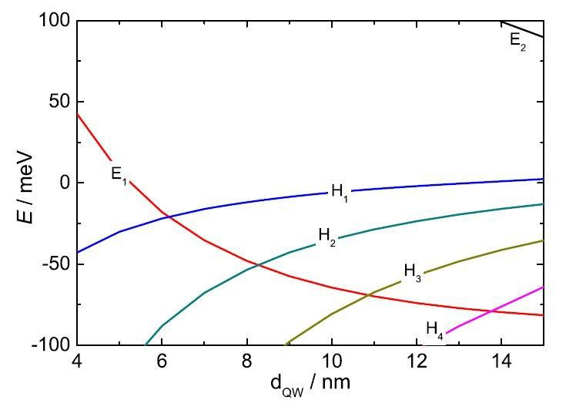
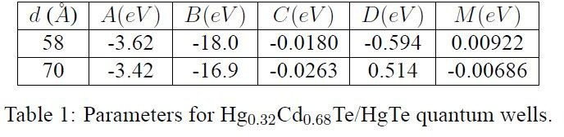
Representation as two state system
ε (k) = C − Dk ² average
d (k ) = ( Ak , Ak , M − Bk ² )
x y 0
mixing gap
Mass inversion occurs for a “wide” quantum well
Bernevig, Hughes and Zhang (BHZ, 2006)

Slide 30
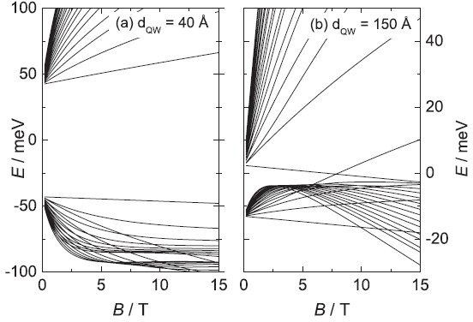
with anomalous Landau quantization
conventional
inverted

Slide 31
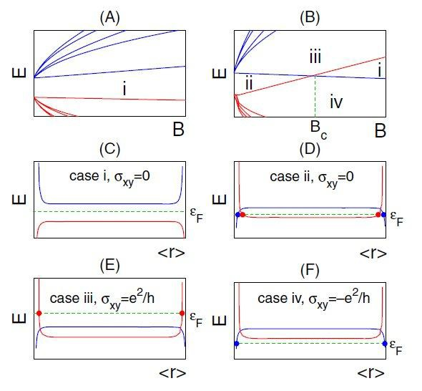
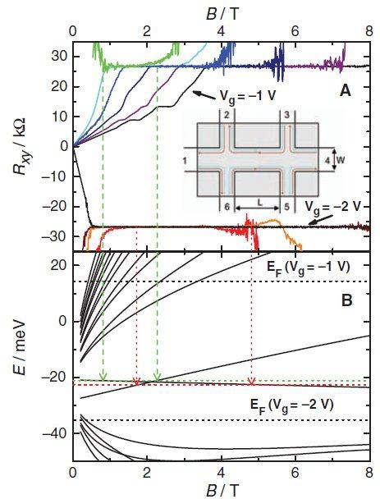
2D QSHE is observed via ballistic transport through its edge modes
Molenkamp group (2007, 2008)

Slide 32
2D experimental status
The realization of 2D QSHE in HgTe quantum wells requires strong spin-orbit coupling and broken cubic symmetry in a thin heterostructure.
(challenging fabrication, T~30 mK, B~ 10 T)
The “decorated graphene” strategy remains an unsolved experimental challenge.
Amazingly, this physics occurs spontaneously in 3D materials that are readily synthesized and measurable at RT.

Slide 33
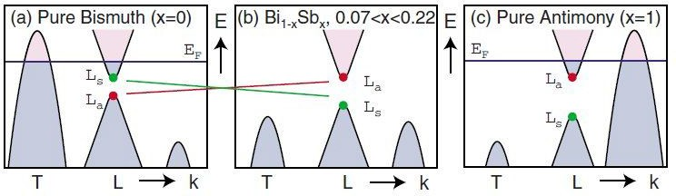
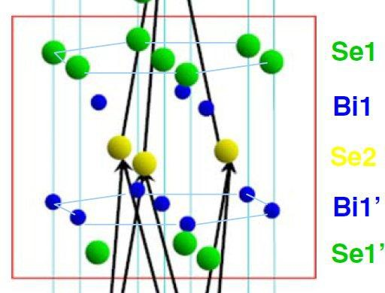
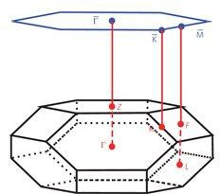
Examples in 3D
Alloys of Bi_{x}Sb_{1-x} : Band inversion at three L points. Z₂=-1 for range of x
Bi₂Se₃
and related tri-chalcogenides. Stacked quintuple layers.
Mass reversal → interface state → spin texture

Slide 34



A kindergarten metaphor
1D Edge of a 2D Topological Insulator is like this
2D Boundary of a 3D Topological Insulator is more like
P.G. Silvestrov, P.W. Brouwer and E.G. Mischenko “On the structure of surface states of topological insulators” arXiv:1111.3650v3
A. Medhi and V.B. Shenoy “Continuum Theory of Edge States of Topological Insulators” arXiv:1202.3863v1
F. Zhang, C.L. Kane and GM “Surface States of Topological Insulators” arXiv:1203.6382v1

Slide 35
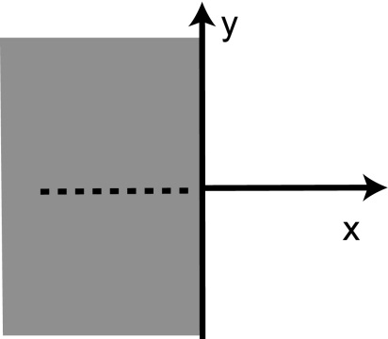
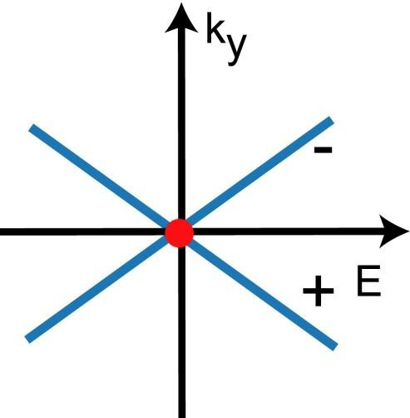
2D topological insulators admits a simple theory of the 1D helical edge states
S.C. Zhang group (2009)
Outline of calculation in 2D :
1. linearize 4 band τ ⊗σ model:
H (k ) = H (k = 0) + ^{∂H} k +…
y y
∂k
y
y
2. H (k_{y} = 0) with node at x=0 admits Kramers degenerate
evanescent solutions: ψ ± (x) = a (e^{λ1 x} − e^{λ2 x} )ϕ± (x)
with τ _{y}ϕ± (x) = ±ϕ± (x)
3. Bulk model prescribes v = ^{∂H} ∝ τ
y
∂k
y
y
the protected edge state is robust
but this result is fragile

Slide 36
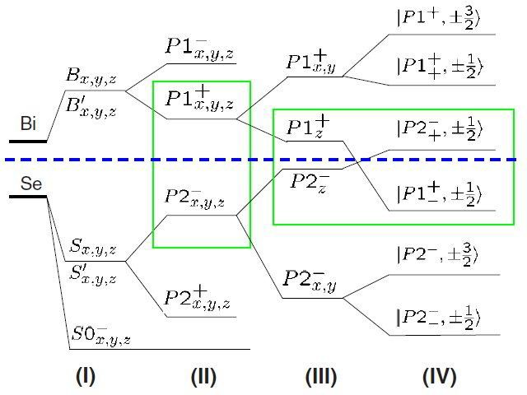
Level ordering in Bi₂Se₃
Layered structure R3m
band inversion
atoms bonds parity crystal field
H. Zhang et al (Shoucheng Zhang group, 2009)
spin orbit

Slide 37
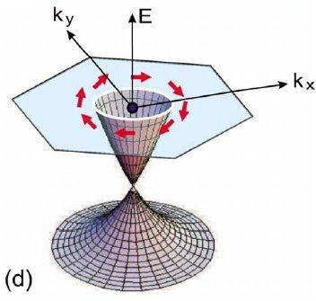
Bi₂Se₃ as TI Prototype
Eight bulk time reversal invariant momenta: Γ, Z, F(3), L(3).
Band inversion is confined to small momenta near Γ (occupied bands “buried” at seven other TRIM).
Hasan/Cava (2009)
ARPES: Single symmetry-protected Dirac cone measured on the (001) face

Slide 38
Graphene
Pairs of DP’s (chiral partners)
Topological Insulator
Single DP
(partner on opposite face)
Gapped by T-preserving
σ_{z} potential (breaks P)
Spin and valley degeneracies hide odd half-integral QHE
h = vσ ⋅ p (helical)
Ungapped by any T-preserving (protected Kramers pair)
Odd half-integral QHE
on a single face (TI=1/4 graphene)
h = v nˆ ⋅σ × p (twisted, chiral)
Face-dependent spectra: topological continuity via side faces
Strong hexagonal warping g ~ 30
Weak antilocalization in both surface and bulk channels
N/A
Weak trigonal warping
g ~ 2
Small quantum corrections in MR

Slide 39
Topological Insulator Surface States
Bulk Boundary Correspondence:
The properties of the edge modes are determined by the bulk symmetries of the materials joined
at the interface. (i.e. mass reversal)
Single Valley Physics:
Bi₂Se₃ –type materials have a single band inversion near Γ. The long wavelength theory is a gradient expansion within a single valley (minimal model).
Bulk Anisotropy:
The bulk Hamiltonian is not isotropic
(Bi₂Se₃ is a layered material). Surface properties are therefore strongly face-dependent.

Slide 40
More precisely
This 3D extension of this idea is subtle.
Most properties of the edge modes (energy in gap,
spin structure, influence of bulk anisotropy, sensitivity to surface localized potentials, etc.) are accessible in the four band theory but require a specification of the boundary condition that terminates the bulk Hamiltonian.
For an ideal termination of a 3D TI this is given by a “topological boundary condition.” For nonideal terminations this is augmented by a two-parameter family of surface localized potentials constrained by P and T symmetries.
Fan Zhang, Kane and GM (2012)

